Slide 1
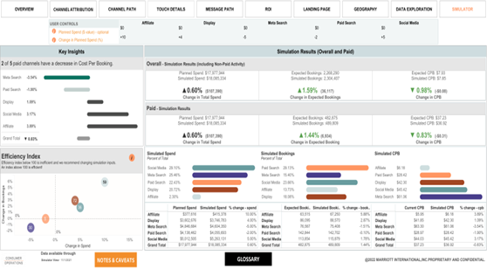
Hospitality - Allocation Optimization with Multi-Touch Attribution
Challenges
Impacts
Client’s current media decisions were supported by last-touch attribution over-estimating organic media.
Last-touch attribution failed to consider early and middle stage interactions and conversion drivers.
Simulation/Optimization based on last-touch is immature and does not consider saturation effects.
Provided incrementality analysis with
multi-touch attribution.
$2.8b Hospitality client was interested in optimal allocation of online advertising budget to paid media channels to maximize the number of bookings
5% increase in conversions with optimal redistribution of spend and decreasing cost per booking by 2%
Solutions
Develop a multi-touch attribution method for customer journey analytics.
Markov Chain Modeling - Modeling media and spending relationships with diminishing returns.
Saturated Curve Fitting - Developing a simulation and an optimization tool for scenario planning and budget decision.
Also developed Non-Linear Constrained Programming.

